Slide 1
Finding the best area in Richmond to open a new or expansion brewery
Brandon Kolljeski
August 25, 2020

Slide 2
Looking at groups of breweries and hotels to find optimal zip code to build
The idea of a business cluster(industry cluster, competitive cluster, Porterian Cluster) was popularized by Michael Porter in his book The Competitive Advantage in 1990
This idea is not new and has been around since the 1890’s with the work of Alfred Marshall and being termed the agglomeration economies
The idea states that similar businesses built close together gain an advantage by generating a few different effects in the localized industry. These effects can include pricing, more customer attraction, innovation in the industry and localizing talent to name a few
By looking at the breweries and accommodations in each zip code in Richmond we will be able to see which areas give the best opportunity

Slide 3
Data Collection and Cleaning
There were no data sets available to the public that included the zip codes, districts and neighborhoods for Richmond, VA, so each one had to be found on its own and then cleaned to fit a larger data set that was used for this project
Location data for breweries and hotels was collected from FourSquare.com using a Get request and pulling relevant data
Even with the large craft beer community in Richmond the data set was fairly small, including only 23 breweries and 16 hotels
The JSON files were pulled into Excel and Power Query was used for cleaning and processing
Cleaning the data was fairly straight forward with minimal errors or null values that needed to be removed

Slide 4
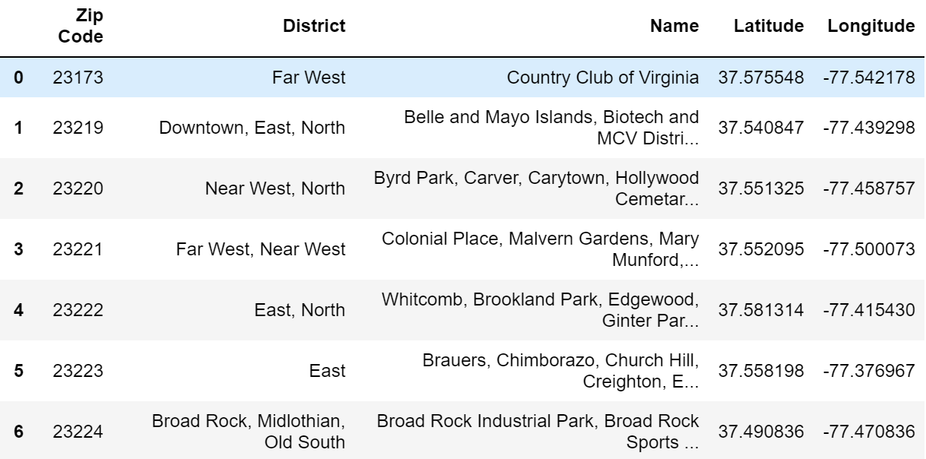
Collected location data to join in the rest of the information

Slide 5
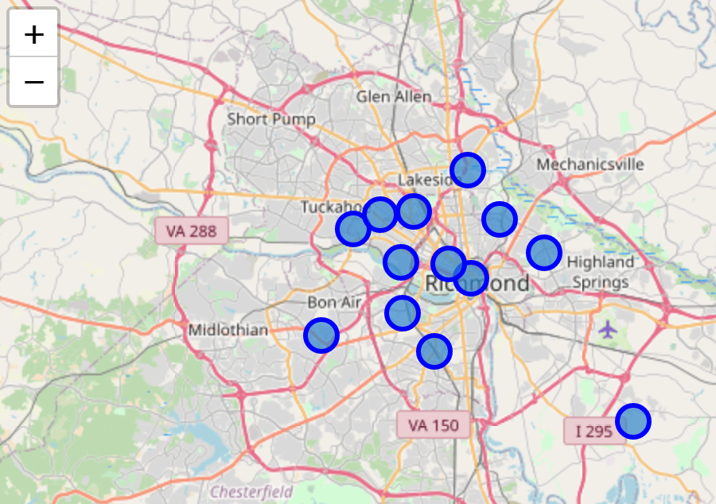
Initial map showing the central points of each zip code

Slide 6
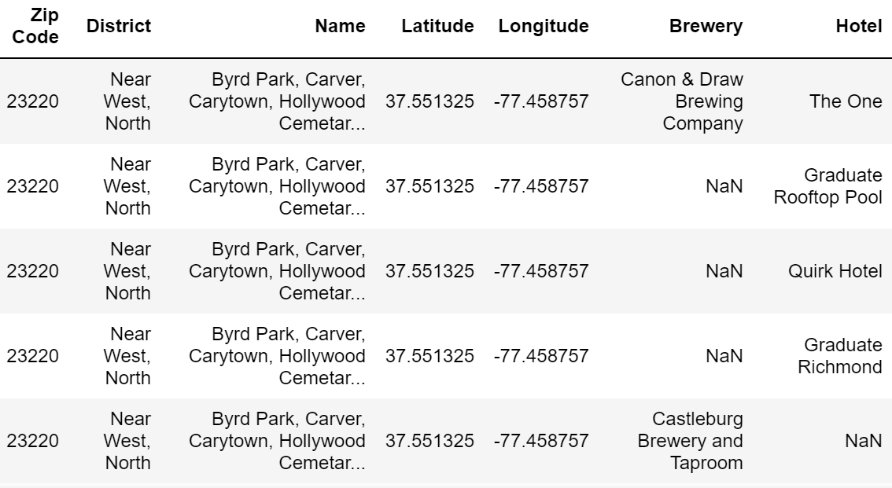
Collected information about breweries and hotels added to the data set

Slide 7
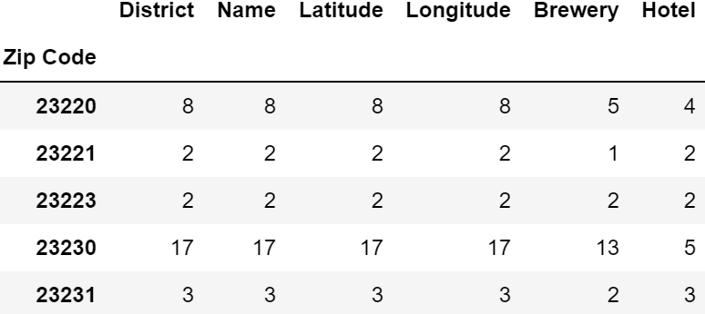
Created the initial Groupby table to see the counts of each item in a zip code

Slide 8
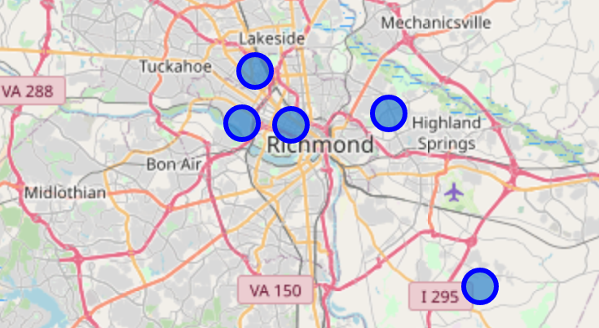
Was able to eliminate most of the zip codes not containing both a brewery and a hotel and map the results

Slide 9
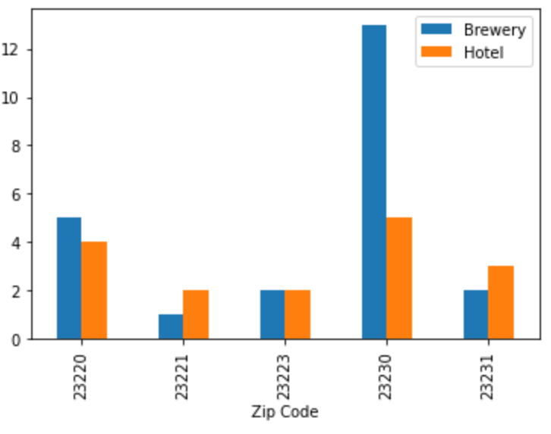
Created a bar graph to give a visual on the total difference between zip codes

Slide 10
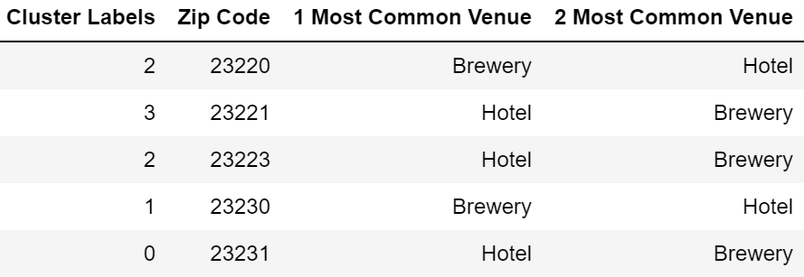
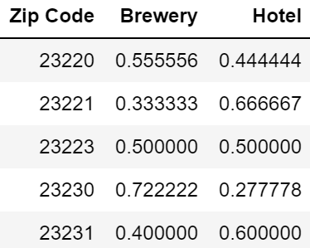
Finally set up kMeans clustering to show groups within the area

Slide 11
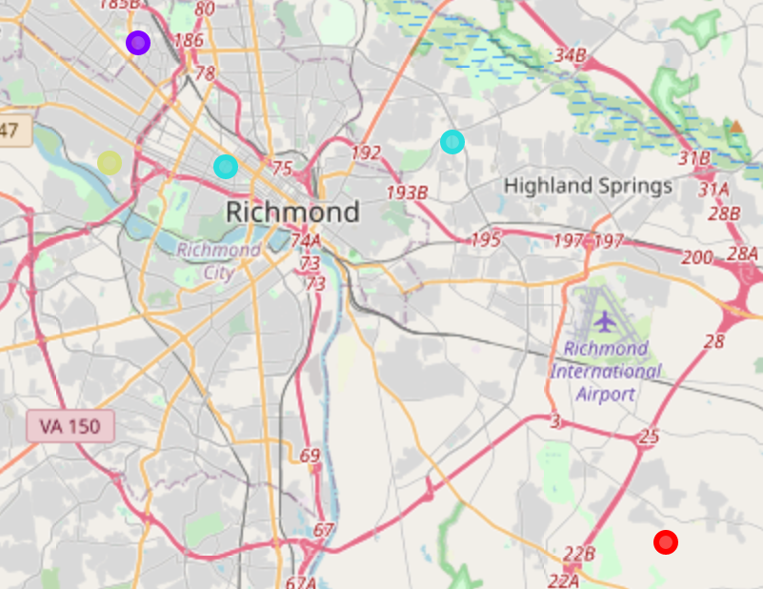
Lastly created a map to show the different clusters and their location

Slide 12
Conclusion and thoughts on future projects
Cluster 1 has the highest brewery and hotel count and would be the zip code to look into if you were building a new brewery or expansion
Future data sets for continuing this project:
Profitability of nearby breweries
Count of check-ins at the breweries and rating on their beers
Which beers they sell the most of day to day
Hotel occupancy and how it affects near by breweries
Other aspects of the area that could increase likelihood of more customer
Parks
Museums
Concert venues
Art galleries

